Slide 1


DYNAMIC TRANSPERINEAL ULTRASOUND IN THE FOLLOW-UP OF PATIENTS UNDERGOING A TRANSOTTURATORY SLING PROCEDURE.
Francesco Trama, Ester Illiano, Elisabetta Costantini.
Andrology and urogynecology Clinic, Santa Maria terni Hospital, University of Perugia, Italy

Slide 2

INTRODUCTION
Following implantation of medium urethral slinging (MUS) for the treatment of stress incontinence (SUI), approximately 5-23% of patients will have residual urinary incontinence.
It has been evaluated in several studies that the recurrence of incontinence may be caused by an incorrect position of the MUS.
AIMS
The aim of our study is to evaluate, by means of trans-perineal ultrasonography, the correct positioning or the possible incorrect position of the network in patients who have undergone midurethral sling transobturator (TOT).

Slide 3
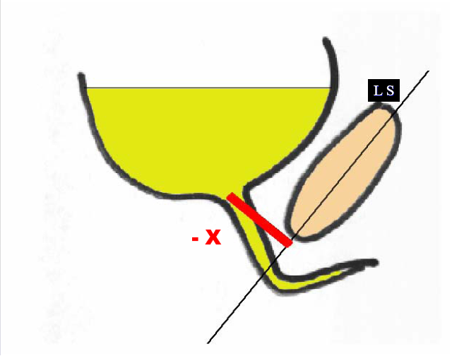
MATERIAL AND METHODS
It is a prospective study performed in a single center.
All patients had their medical history recorded, objective examination was performed, and transperineal ultrasound (TPU) was performed.
Patients were followed up at 1, 3, 6, 12 months after surgery and annually thereafter. At 6 months after surgery, transperineal ultrasound with ISR measurement was repeated.
We recorded the measurement above and below the longitudinal axis of the symphysis as negative and positive, respectively
Further parameters evaluated are:
the position of the mesh along the urethra: it was calculated by means of a mathematical formula which takes in account the urethral length to obtain 3 different position:
1) 0-40% proximal to the bladder neck
        2) 40-60% midurethral position
        3) 60-100% distal position;
b) the movement and in particular the symmetry of the lateral arms of the mesh during straining .
c) the presence or absence of an open bladder neck.

Slide 4
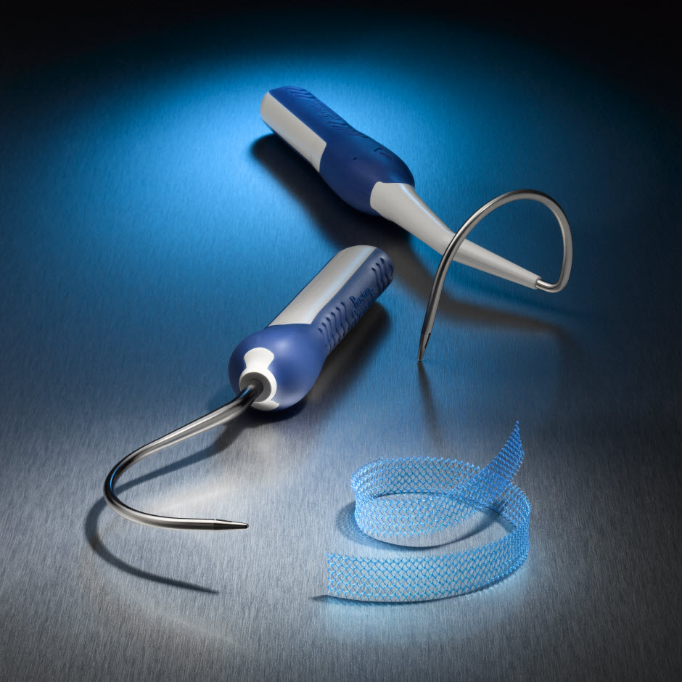
RESULTS
From January 2013 to February 2016, 86 patients were recruited who underwent TOT.
The follow-up - up on average 36 months (range 12-72). Following TOT 67 (77.9%) patients were completely continental and 19 (22.1%) patients had residual incontinence.
It was assessed by transperineal ultrasonography that incontinent women had more distal slings compared to continental women (p=0.004);
  a.in incontinent women there was a greater prevalence of sling arm asymmetry compared to continental women (p<0.0001);
  b. incontinent women had more distal slings compared to continent patients (p<0. 0001);
  c. of women with open bladder neck openings, it was observed that sling placement was distally placed compared to patients with closed bladder neck (37.8% vs 0%, p<0.0001).
With MUS, continent women had an improvement of urethrocele grade at rest (p=0.028) and during Valsalva (p=0.044), and lower movement of urethra from rest to during Valsava (p=0.041).

Slide 5


CONCLUSION
ultrasound is a non-invasive, inexpensive method that allows you to predict information about the correct position and functioning of the TOT sling.

